Slide 1
GFlowNet
Flow Network based Generative Models for Non-Iterative Diverse Candidate Generation (https://arxiv.org/abs/2106.04399)
Emmanuel Bengio, Moksh Jain, Maksym Korablyov, Doina Precup, Yoshua Bengio (2021)

Slide 2
GFlowNet in my understanding
An algorithm to solve combinatorial black-box problems (i.e., inputs are seen as sequences of discrete elements)
We can sample solutions from the trained model.
Advantages
efficient for learning and sampling promising solutions
can sample diverse high-quality solutions

Slide 3
https://neurips.cc/media/neurips-2021/Slides/26729.pdf

Slide 4
https://neurips.cc/media/neurips-2021/Slides/26729.pdf

Slide 5
https://www.youtube.com/watch?v=7W69-ffTs48

Slide 6
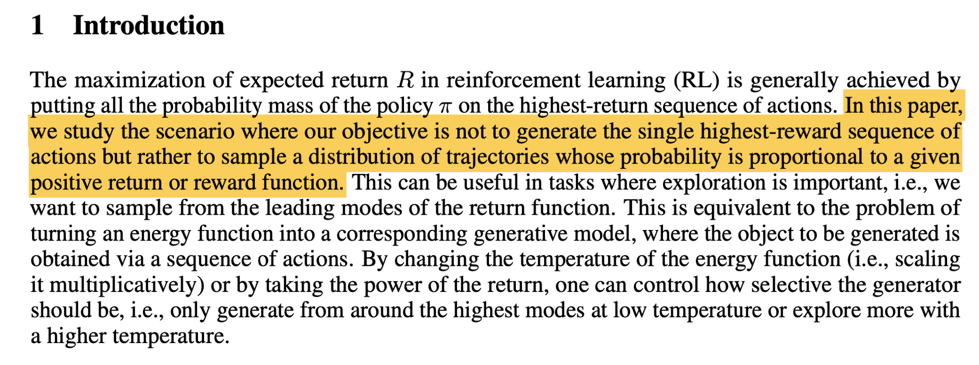
Introduction

Slide 7
Introduction

Slide 8
Introduction

Slide 9
Flow Networks
https://www.youtube.com/watch?v=7W69-ffTs48

Slide 10
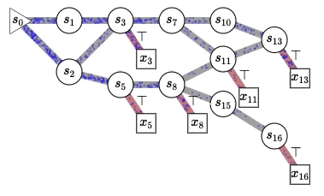
Flow Networks
Example: s_n: partial molecule
x_n: complete molecule
https://fburl.com/1p8k4sj4

Slide 11
Flow Networks
https://fburl.com/1p8k4sj4

Slide 12
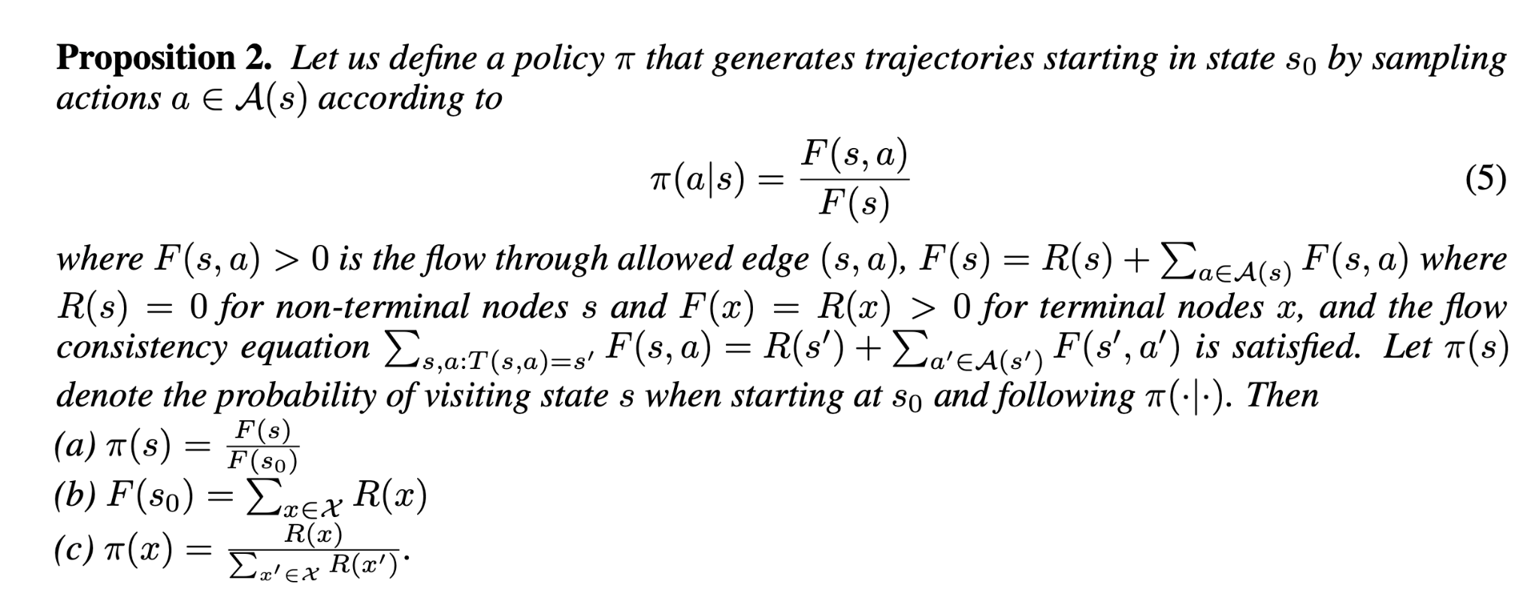

Slide 16
Objective Functions
AKA Flow matching: the sum of entering flows into a state matches the sum of outgoing flows from a state

Slide 17
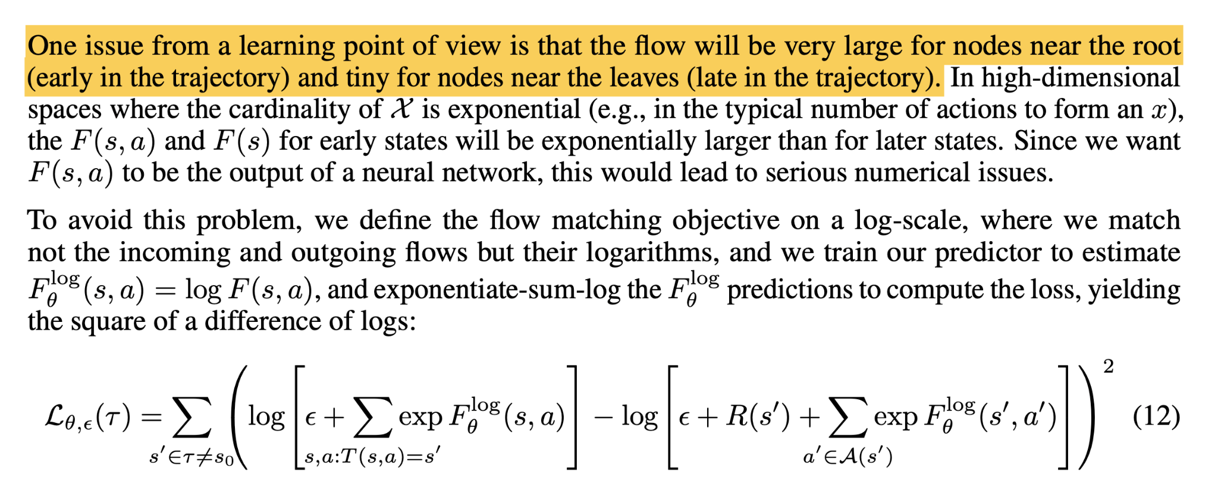
Objective Fucntions

Slide 18
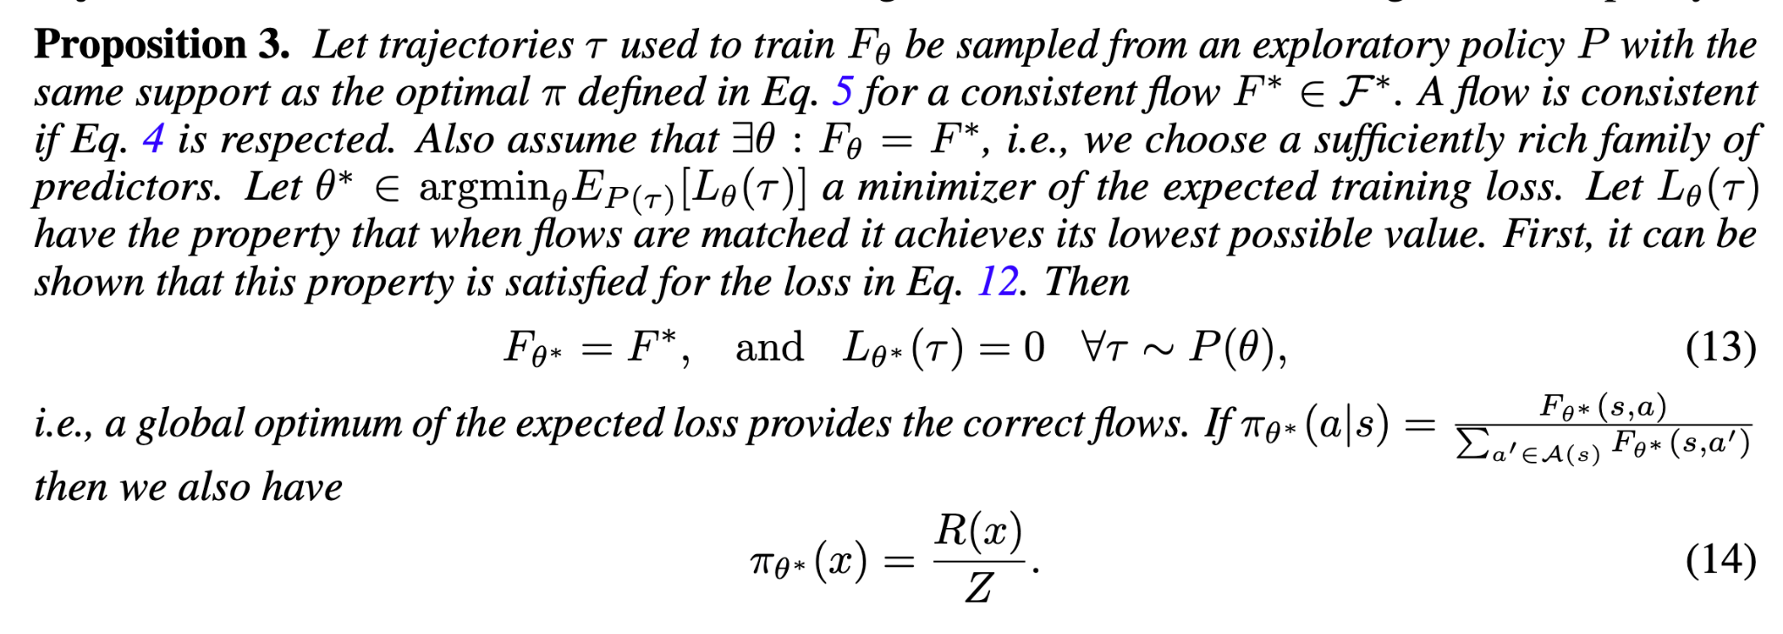

Slide 19
Experiments

Slide 20
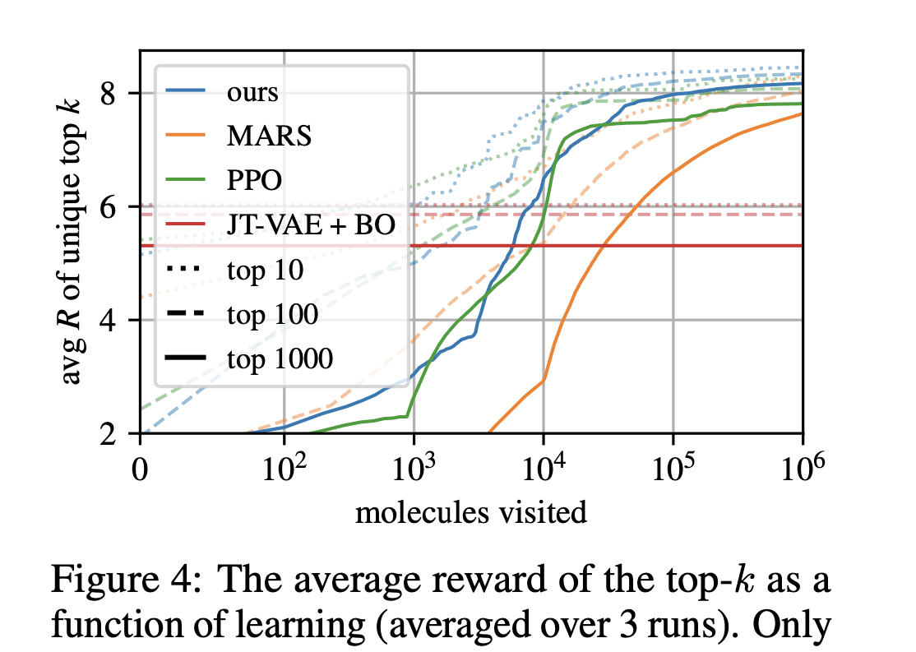
Experiments

